Slide 1

AHG223 Shooting Game
<Deal with Jframe & Button>
Ahn Hyung Geun
Notes:
안녕하세요? 독일 해외교육과정을 발표했던 2조입니다. 이번 발표에는 저와 신윤수 학우가 정보기술과 활용 교과서 분석 및 선생님 현장 인터뷰에 대한 발표를 진행하겠습니다.
본 발표를 위해 김유경 학우가 피피티 총 디자이너를 맡아줬고 동영상 편집의 달인 주혜지 학우가 인터뷰영상 편집에 힘을 써줬습니다.

Slide 2




INDEX
1
2
3
4
Simulate
Shooting Game
About
Class & Method
Interaction between Class
Learning in
This Course
Notes:
다음은 목차입니다. 교과서 분석에 앞서 도입부분에서는 정보컴퓨터교과목에 대한 전반적인 이야기를 잠시 하겠습니다. 교과서 분석을 신윤수학우가 발표해주고, 다시 제가 학교현장에서의 교과서에 대한 인터뷰 영상 요약을 하겠습니다.

Slide 3
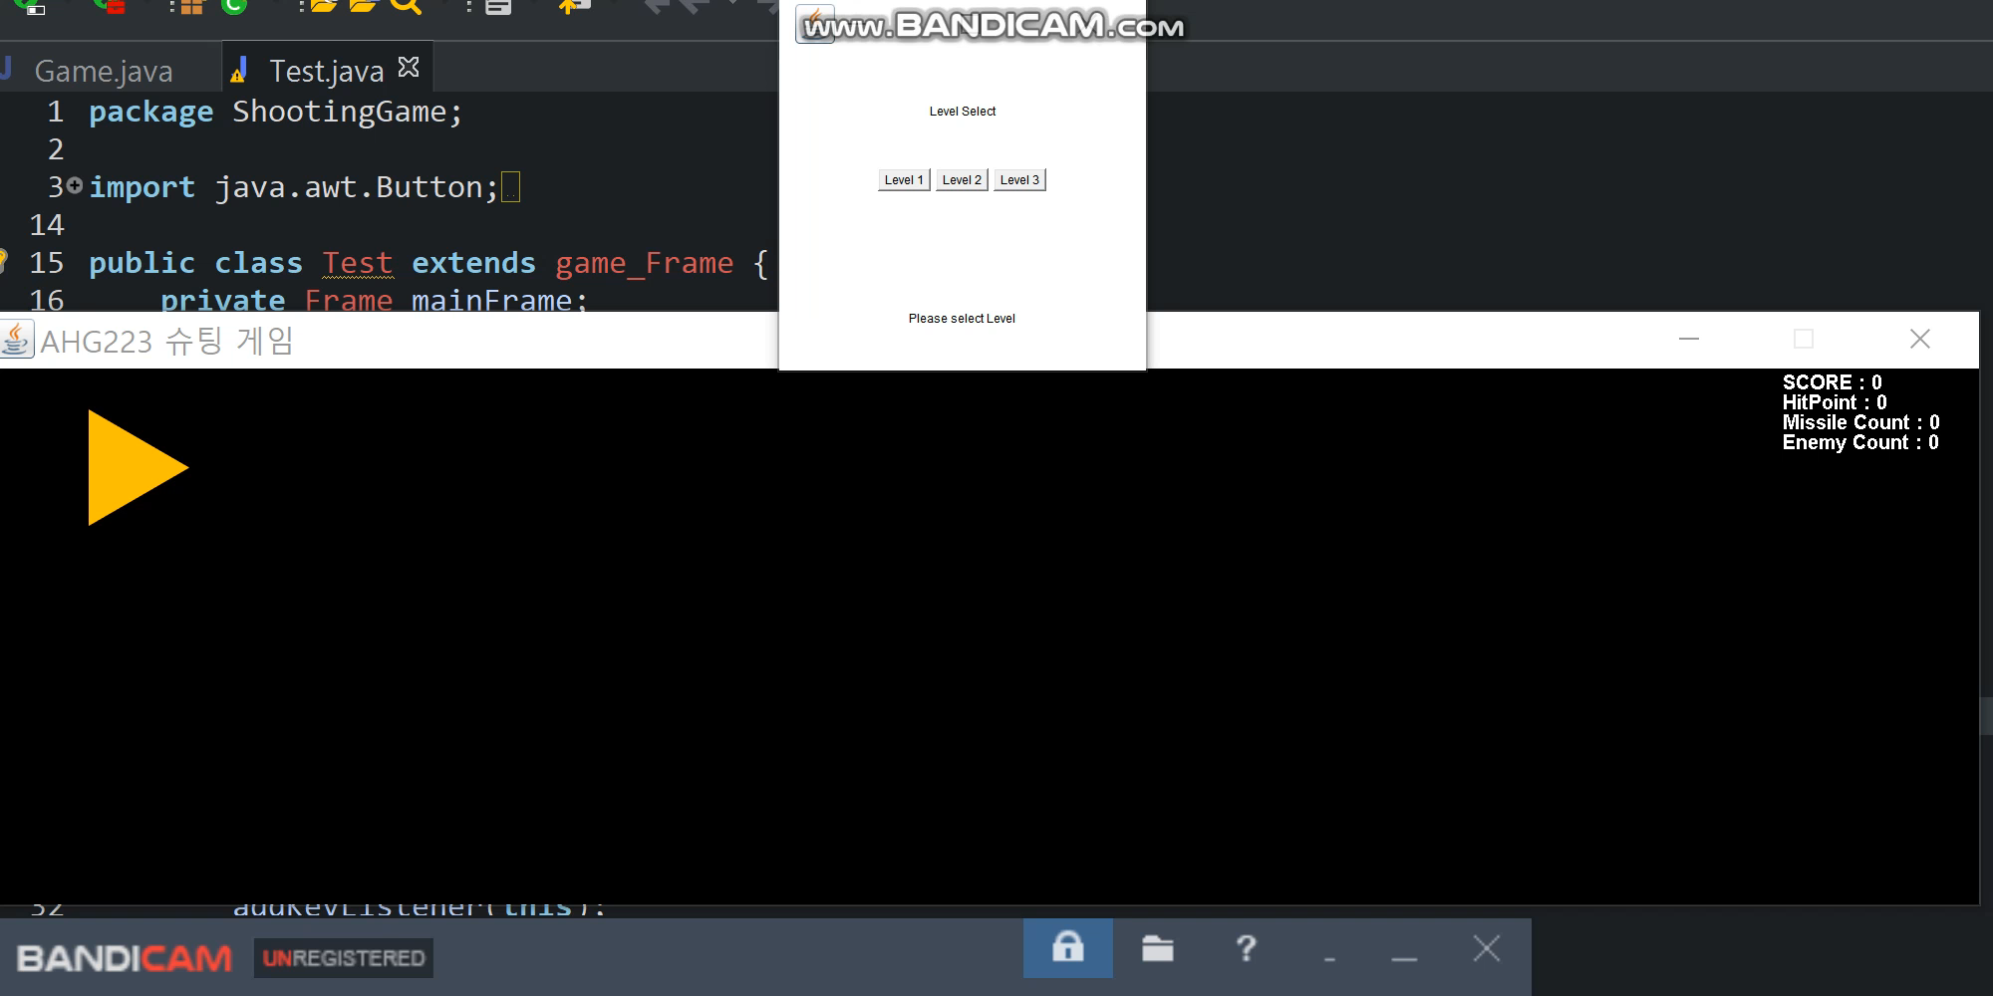
1. Simulating Game | 2. About Class & Method | 3. Interact between Class | 4. Learning In this Course
Simulating Game
Shooting Game
Player can choose
level of game
Player’s speed, bullet
speed, reload is different
Left upper side show
hp and score of player
Notes:
다 아시는 내용이겠지만, 그래도 짚고 넘어가야할 내용이라 말씀을 드리려고 합니다 . 저희가 분석한 교과서는 09 개정교육과정 정보기술과 활용 교과서이며 2015 개정 교육과정은 내년인 2018년부터 단계적으로 적용되며
현재 3학년인 학생이 졸업과 동시에 임용시험을 통과후 2019년부터 교단에 서게 될 경우는 저희들이 분석한 09개정교육과정 교과서가 아닌 2015 개정교육과정 교과서를 통해 중고등학교 1~2학년 학생을 가르치게 될 것입니다.
2020년에는 초중고 전학년에 2015 개정 교육 과정이 적용됩니다.

Slide 4
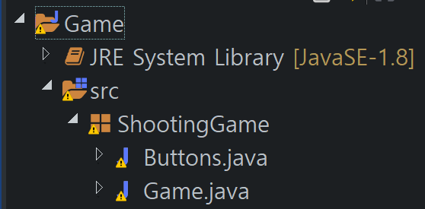
1. Simulating Game | 2. About Class & Method | 3. Interact between Class | 4. Learning In this Course
1 Package, 2 Java Files, 6 Classes
Shooting Game
Game
Buttons
Buttons
Game
Enemy
Missile
game_ Frame
Explosion
Structure of Source Code
About Shooting Game Package
Package of this source code
Include 2 Java File – Game.java, Buttons.java

Slide 5
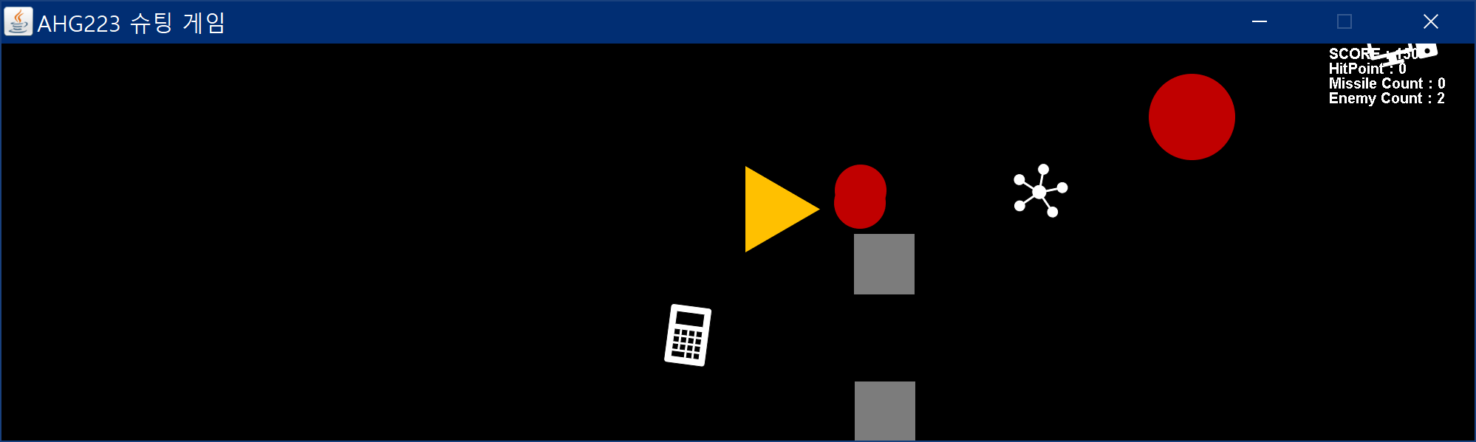
1. Simulating Game | 2. About Class & Method | 3. Interact between Class | 4. Learning In this Course
1 Package, 2 Java Files, 6 Classes
Shooting Game
Game
Buttons
Buttons
Game
Enemy
Missile
game_ Frame
Explosion
Structure of Source Code
About Game.java
Related with shooting game
Contain 5 classes which
composed of shooting game

Slide 6
1. Simulating Game | 2. About Class & Method | 3. Interact between Class | 4. Learning In this Course
1 Package, 2 Java Files, 6 Classes
Shooting Game
Game
Buttons
Buttons
Game
Enemy
Missile
game_ Frame
Explosion
Structure of Source Code
About Explosion class
Method. Explosion(x, y, damage)
Parameter x, y = location of Explosion
Damage=0 : Missile, Enemy Explosion
Damage=1 : Player Explosion

Slide 7
1. Simulating Game | 2. About Class & Method | 3. Interact between Class | 4. Learning In this Course
1 Package, 2 Java Files, 6 Classes
Shooting Game
Game
Buttons
Buttons
Game
Enemy
Missile
game_ Frame
Explosion
Structure of Source Code
About Enemy class
Method. Enemy(x, y, speed)
Parameter x, y: location of Enemy
Parameter speed: speed of Enemy
Method. move() – x-=speed;
Location is changed by subtract speed

Slide 8
1. Simulating Game | 2. About Class & Method | 3. Interact between Class | 4. Learning In this Course
1 Package, 2 Java Files, 6 Classes
Shooting Game
Game
Buttons
Buttons
Game
Enemy
Missile
game_ Frame
Explosion
Structure of Source Code
About Missile class
Method. Missile(x, y, speed)
Parameter x, y: location of Missile
Parameter speed: speed of Missile
Method. move() +x-=speed;
Location is changed by add speed
Different direction with Enemy

Slide 9
1. Simulating Game | 2. About Class & Method | 3. Interact between Class | 4. Learning In this Course
1 Package, 2 Java Files, 6 Classes
Shooting Game
Game
Buttons
Buttons
Game
Enemy
Missile
game_ Frame
Explosion
Structure of Source Code
About Game class
Just for main class
Game_Frame AHG223 = new game_Frame();
Nothing else with out upper object

Slide 10
1. Simulating Game | 2. About Class & Method | 3. Interact between Class | 4. Learning In this Course
1 Package, 2 Java Files, 6 Classes
Shooting Game
Game
Buttons
Buttons
Game
Enemy
Missile
game_ Frame
Explosion
Structure of Source Code
About game_Frame class
Extends Jframe
Implements KeyListener, and Runnable
This class contains player info and GUI of
game.
This class contains all interact between Game.java classes. Present at 3rd index

Slide 11
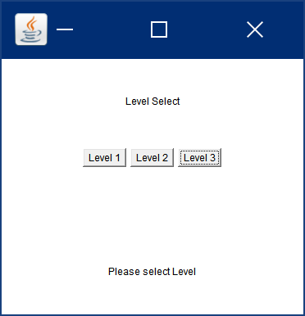
1. Simulating Game | 2. About Class & Method | 3. Interact between Class | 4. Learning In this Course
1 Package, 2 Java Files, 6 Classes
Shooting Game
Game
Buttons
Buttons
Game
Enemy
Missile
game_ Frame
Explosion
Structure of Source Code
About Button.java
This java file deal with level of shooting game by button package

Slide 12
1. Simulating Game | 2. About Class & Method | 3. Interact between Class | 4. Learning In this Course
1 Package, 2 Java Files, 6 Classes
Shooting Game
Game
Buttons
Buttons
Game
Enemy
Missile
game_ Frame
Explosion
Structure of Source Code
About Button class
Just for control level of shooting game by button
Lv Button decide score, player HP, speed of player, missile, enemy and reload of missile
No need to deal with swings.jbutton, awt.button is enough for this project

Slide 13
1. Simulating Game | 2. About Class & Method | 3. Interact between Class | 4. Learning In this Course
Game.java – Interact between 5 classes
Shooting Game
Game
Game
Enemy
Missile
game_ Frame
Explosion
Structure of Source Code
About GUI
Method. game_Frame contains
method init and start
Init: assign image to object or animation
Start: starting thread
Method. Update & draw: drawing each object image then update on frame
Notes:
다 아시는 내용이겠지만, 그래도 짚고 넘어가야할 내용이라 말씀을 드리려고 합니다 . 저희가 분석한 교과서는 09 개정교육과정 정보기술과 활용 교과서이며 2015 개정 교육과정은 내년인 2018년부터 단계적으로 적용되며
현재 3학년인 학생이 졸업과 동시에 임용시험을 통과후 2019년부터 교단에 서게 될 경우는 저희들이 분석한 09개정교육과정 교과서가 아닌 2015 개정교육과정 교과서를 통해 중고등학교 1~2학년 학생을 가르치게 될 것입니다.
2020년에는 초중고 전학년에 2015 개정 교육 과정이 적용됩니다.

Slide 14
1. Simulating Game | 2. About Class & Method | 3. Interact between Class | 4. Learning In this Course
Game.java – Interact between 5 classes
Shooting Game
Game
Game
Enemy
Missile
game_ Frame
Explosion
Structure of Source Code
About Process
Enemy process add score, subtract player HP when crashed with enemy
Missile process remove missile and enemy when they are crash
Every process assign or delete own object on each array list
Notes:
다 아시는 내용이겠지만, 그래도 짚고 넘어가야할 내용이라 말씀을 드리려고 합니다 . 저희가 분석한 교과서는 09 개정교육과정 정보기술과 활용 교과서이며 2015 개정 교육과정은 내년인 2018년부터 단계적으로 적용되며
현재 3학년인 학생이 졸업과 동시에 임용시험을 통과후 2019년부터 교단에 서게 될 경우는 저희들이 분석한 09개정교육과정 교과서가 아닌 2015 개정교육과정 교과서를 통해 중고등학교 1~2학년 학생을 가르치게 될 것입니다.
2020년에는 초중고 전학년에 2015 개정 교육 과정이 적용됩니다.

Slide 15
1. Simulating Game | 2. About Class & Method | 3. Interact between Class | 4. Learning In this Course
What I learn through this course – Object Design
Designing based upon on Object
More proficient Top-down design
When I learn C++, I design class as path of data
I’m used to procedural programming cause start programming by C language
But through this class, I finally learn the concept of class
This course make me another way to designing Top-down way
Can design program perspective of Object
More convenient, more efficient

Slide 16
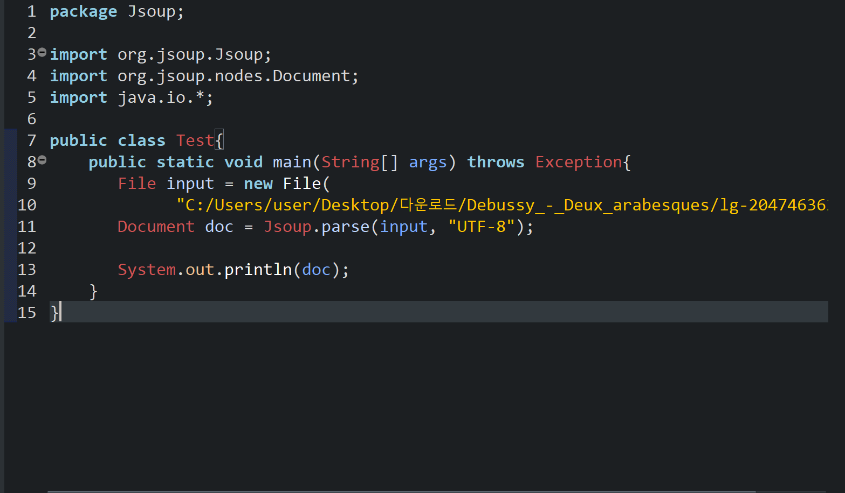
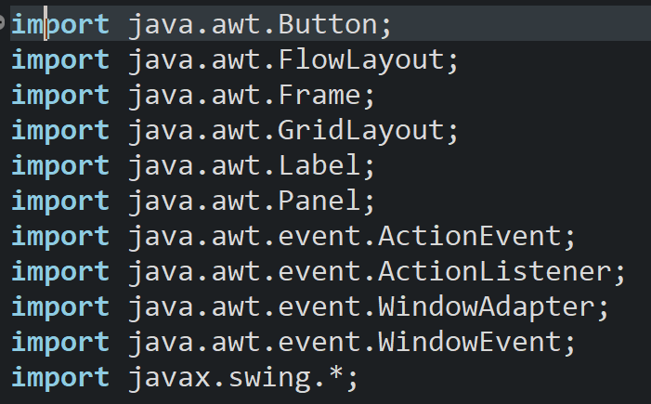
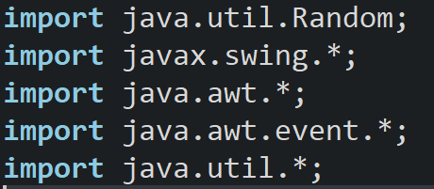
1. Simulating Game | 2. About Class & Method | 3. Interact between Class | 4. Learning In this Course
What I learn through this course – Variable library
Compiler course – XML by Jsoup
GUI library – awt & swing
Compiler Course: Make JAVA can read XML(UTF-8) File
OOPS course: Make GUI of Shooting Game by library

Slide 17
Thank you

